Slide 1
Building cross-platform multimedia apps with Xamarin
Andoni Morales & Victor Guzmán

Slide 2
Who are we?

Slide 3

Andoni Morales Alastruey
@ylatuya
LongoMatch founder
Open source contributor
GStreamer: Adaptive Streaming, audio/video codecs, muxers, Windows, macOS, Android and iOS ports
Author of Cerbero: cross-platform build system aggregator for the GStreamer project
Flumotion: distributed media streaming server
XAMLator: Live previewer with Hot Reload for Xamarin.Forms
Other: Mono, Xamarin.Forms, GCC, MinGW, WebKit, GLib, libvpx, libffi, Gtk+, …
Currently working in Fluendo
Former professional field hockey player

Slide 4

Víctor Guzmán Pedrajas
LongoMatch & RiftGG developer & scrum master for about 3 years
Open source contributor wannabe
Always wanting to contribute, but never getting started
Currently working in Fluendo
Brazilian Jiu-Jitsu amateur
Board game lover

Slide 5

What is this talk about?

Slide 6
¿De qué se trata?
Os daremos la chapa con nuestras batallitas
Os contaros cómo creamos LongoMatch y RiftGG para Windows, Linux, macOS, Android e iOS
Os explicaremos qué architectura y patrones seguimos en nuestras aplicaciones y cómo los usamos
También detallaremos la stack tecnológica con la que trabajamos
Os hablaremos de nuestros procesos de Testing y DevOps
Nos quejaremos de las cosas que no funcionan y alabaremos las que sí
Una colección de gifs awesómica

Slide 7


LongoMatch and RiftGG

Slide 8


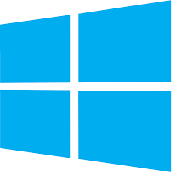

What platforms do we target?

Slide 9
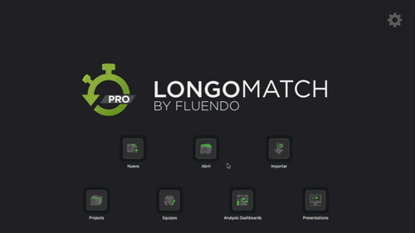
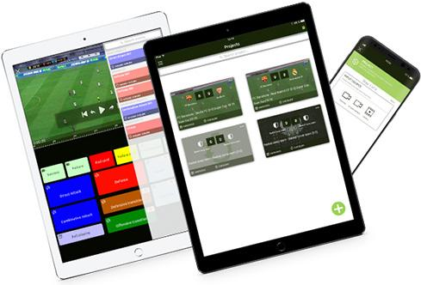
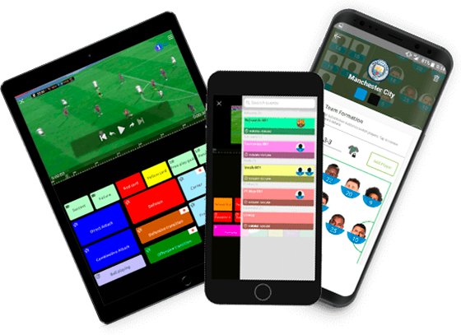
LongoMatch
Video analysis software for coaches and analysts allowing to tag events in a game and create vídeo reports
Features
Live recording from video cameras
Advanced video player
Video editor
Drawing tool
Stats
Teams and dashboards editor

Slide 10
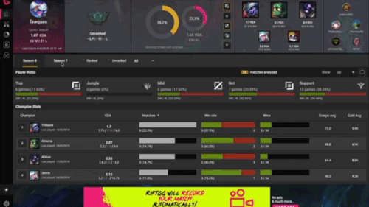
RiftGG
Statistics tool for League of Legends
Records your games automatically
Creates highlights and allows to easily share them on social media

Slide 11

A little bit of history

Slide 12
Timeline
.NET Foundation
Microsoft Acquires Xamarin
Microsoft announces the .NET core, the .NET Foundation and updates its patent grants
2014
2016
Mono is relicensed to MIT Xamarin.Android and Xamarin.iOS are open sourced
2000
2001
2008
2012
2016
2017
2017
.NET Framework
Mono
LongoMatch Windows + Linux
LongoMatch
OS X
Tag2Win
iOS + Android
RiftAnalyst Windows + macOS
LongoMatch
iOS + Android
Microsoft creates .NET framework
The Mono project starts to provide an open source .NET framework implementation
First release of LongoMatch for Windows and Linux
First release of LongoMatch for OS X
First release of Tag2Win for iOS and Android
First release of RiftAnalyst now RiftGG for Window and macOS
First release of LongoMatch for iOS and Android
Notes:
.Net Foundation
Announced in 2014, it started with 24 projects under the foundation umbrella, including Roslyn and ASP.NET
After that came .NET Core, MSBuild, NuGet, Mono
It’s the beginning of a very important Open Source movement in the .NET world
Microsoft becomes the company with more open source contributors in GitHub with ~1,300, followed by Google with ~900
Many .NET Windows developers start contributing to Open Source creating tons of new projects and libraries.
Microsoft Acaquires Xamarin
In February 2016, Xamarin is Acquired by Microsoft
Mono is relicensed to MIT
All Xamarin projects (Xamarin.Android, Xamarin.iOS, etc) are open sourced as MIT and part of the .NET Foundation
Developers can now write cross-platform applications without any extra license cost!

Slide 13

Building cross-platform applications with Xamarin

Slide 14
Rule of thumb
Xamarin.Forms is just another Dependency
We are not cross-platform because we use Xamarin.Forms. We build cross-platform apps and Xamarin.Forms is the correct technology to do it in some platforms.
We define interfaces for each single service we plan to implement, and then we find the correct implementation (even if this implementation is reused in all platforms).
This make testing much easier because everything can be mocked!

Slide 15
Examples: ISecureStorage
Interface definition
Android and iOS implementation using Plugin.SecureStorage
public interface ISecureStorage { string GetValue (string key); bool SetValue (string key, string value); }
using Plugin.SecureStorage;
public class SecureStorage : ISecureStorage {
const string PASSWORD = "CasiMeDejoElBueno"; static SecureStorageService () { #if OSTYPE_ANDROID SecureStorageImplementation.StoragePassword = PASSWORD; #endif } public string GetValue (string key) => CrossSecureStorage.Current.GetValue (key); public bool SetValue (string key, string value) { if (value == null) { return CrossSecureStorage.Current.DeleteKey (key); } return CrossSecureStorage.Current.SetValue (key, value); } }

Slide 16
Is Xamarin and Xamarin.Forms a good fit?
Xamarin makes C# development in Mobile platforms possible, so yes!
A few years ago, Xamarin.Forms didn’t support desktop platforms, now it supports all of them.
You can go for a fully native UI or choose the Gtk+ backend which provides the same UI across all platforms.
Xamarin.Forms.Shell is going to be a game changer!

Slide 17

Tech Stack

Slide 18
LongoMatch Desktop
LongoMatch Mobile
RiftAnalyst
RA.DB
LongoMatch Core
RiftAnalyst Core
VAS
Services
Database
Multimedia Engine
2D Drawing Engine
UI Engine
Cairo
Android Graphics
Couchbase
Google Cloud Store
GStreamer
Android Media
AV Foundation
GTK+
Xamarin.Forms
Core Graphics
Skia
Xamarin.Mac
Xamarin.Android
Xamarin.iOS
Mono
.NET Framework
.NET Core

Slide 19
LongoMatch Desktop
LongoMatch Mobile
RiftAnalyst
RA.DB
LongoMatch Core
RiftAnalyst Core
VAS
Services
Database
Multimedia Engine
2D Drawing Engine
UI Engine
Cairo
Android Graphics
Couchbase
Google Cloud Store
GStreamer
Android Media
AV Foundation
GTK+
Xamarin.Forms
Core Graphics
Skia
Xamarin.Mac
Xamarin.Android
Xamarin.iOS
Mono
.NET Framework
.NET Core

Slide 20
LongoMatch Desktop
LongoMatch Mobile
RiftAnalyst
RA.DB
LongoMatch Core
RiftAnalyst Core
VAS
Services
Database
Multimedia Engine
2D Drawing Engine
UI Engine
Cairo
Android Graphics
Couchbase
Google Cloud Store
GStreamer
Android Media
AV Foundation
GTK+
Xamarin.Forms
Core Graphics
Skia
Xamarin.Mac
Xamarin.Android
Xamarin.iOS
Mono
.NET Framework
.NET Core

Slide 21
LongoMatch Desktop
LongoMatch Mobile
RiftAnalyst
RA.DB
LongoMatch Core
RiftAnalyst Core
VAS
Services
Database
Multimedia Engine
2D Drawing Engine
UI Engine
Cairo
Android Graphics
Couchbase
Google Cloud Store
GStreamer
Android Media
AV Foundation
GTK+
Xamarin.Forms
Core Graphics
Skia
Xamarin.Mac
Xamarin.Android
Xamarin.iOS
Mono
.NET Framework
.NET Core

Slide 22
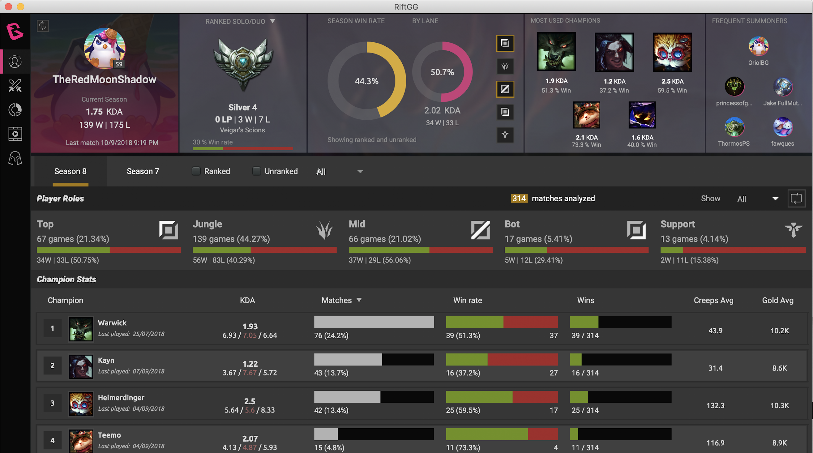
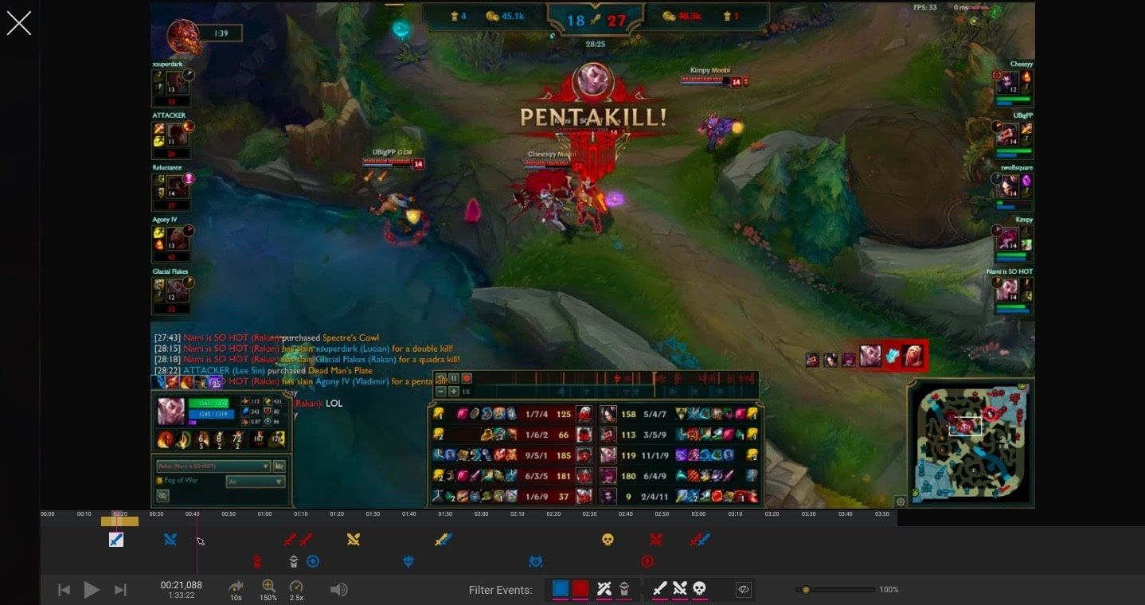
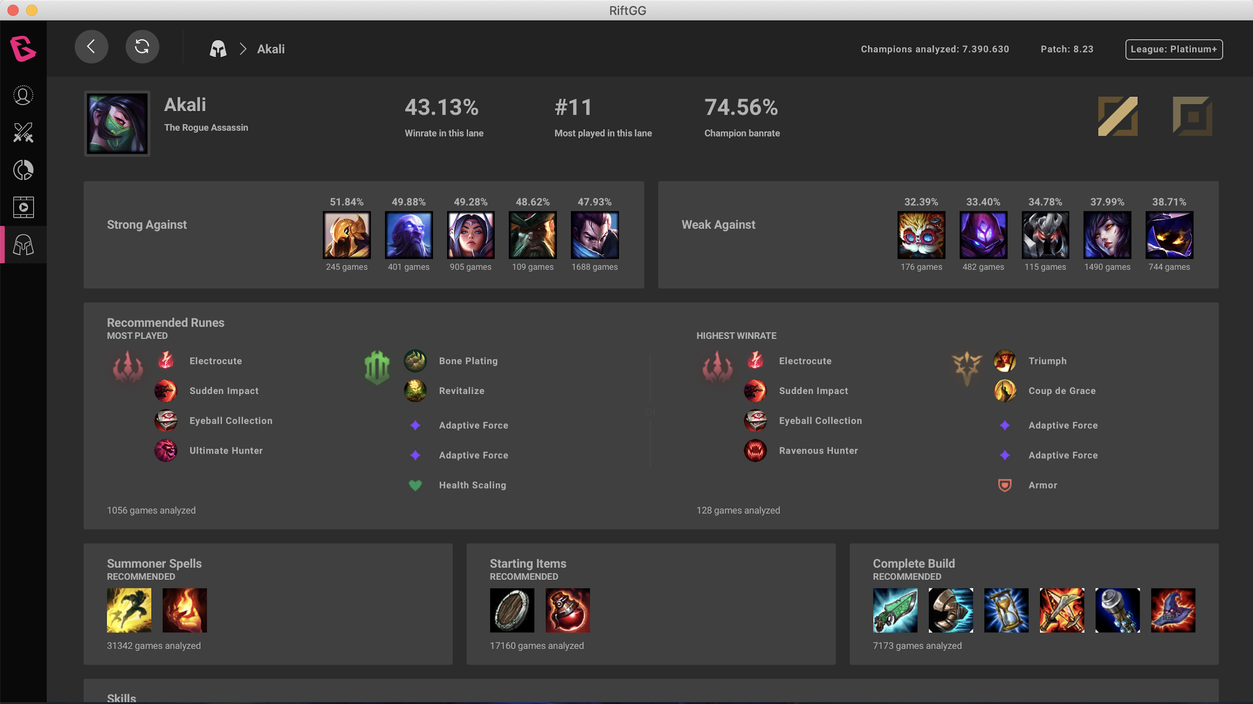
Quiz: What tech is being used, Xamarin.Forms, Gtk+, HTML5 ?
GTK+
Xamarin.Forms
HTML5 Vue.js

Slide 23
UI Engine

Slide 24
Backends
UI Engine
Android: Xamarin.Forms
iOS: Xamarin.Forms
macOS: Gtk+, Xamarin.Forms
Windows: Gtk+, Xamarin.Forms
GTK+
Xamarin.Forms

Slide 25
Abstractions: IUIToolkit
public interface IUIToolkit { IMainWindow MainWindow { get; } bool FullScreen { set; } void Invoke (EventHandler handler); Task<T> Invoke<T> (Func<Task<T>> handler); Type FindView<T> () where T : IViewModel; void InitTrayIcon (Image appImage); void Present (); void Iconify (bool iconify); void EnableNavigations (bool enabled); }

Slide 26
Abstractions: IDialogs
public interface IDialogs { /* Messages */ void InfoMessage (string message, object parent = null); void WarningMessage (string message, object parent = null); Task ErrorMessage (string message, object parent = null); /* Files/Folders IO */ string SaveFile (string title, string defaultName, string defaultFolder, string filterName, string [] extensionFilter); string OpenFile (string title, string defaultName, string defaultFolder, string filterName = null, string [] extensionFilter = null); Task<T> PickFrom<T> (IEnumerable<T> collection) where T : IViewModel;
[.........] }

Slide 27
Abstractions: INavigation
public interface INavigation { Task<bool> Push (IPanel panel); Task<bool> Pop (IPanel newPanel); Task PushModal (IPanel panel,
IPanel parent); Task PopModal (IPanel panel); }
public Task Push (IPanel panel) { return Navigation.PushAsync (panel as Page); } public Task Pop (IPanel panel) { return Navigation.PopAsync (); } public Task PushModal (IPanel panel, IPanel parent) { return Navigation.PushModalAsync (panel as Page); } public virtual Task PopModal (IPanel panel) { return Navigation.PopModalAsync (); }

Slide 28

Multimedia Engine

Slide 29
Features
Multimedia Engine
IVideoPlayer: Multimedia player
IVideoEditor: non-linear video edition
ICapturer: live video recorder
IDiscoverer: multimedia discoverer
IFramesCapturer: takes screenshots from a video file
IRemuxer: remuxes video files a video file
GStreamer
Android Media
AV Foundation

Slide 30
Backends
GStreamer:
Windows, macOS, Linux
AV Foundation:
iOS
Android Media Codec API:
Android

Slide 31
Is GStreamer a good choice nowadays?
It’s mature on Windows, Linux, macOS and iOS
It’s not very mature in Android yet, but it’s getting better
It’s very flexible, but has a high entry barrier
It’s hard to package and distribute
On Android and iOS we ended up doing per-platform implementations

Slide 32

2D Drawing Engine

Slide 33
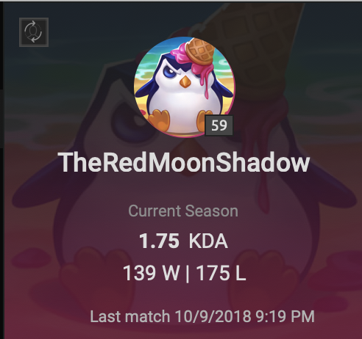
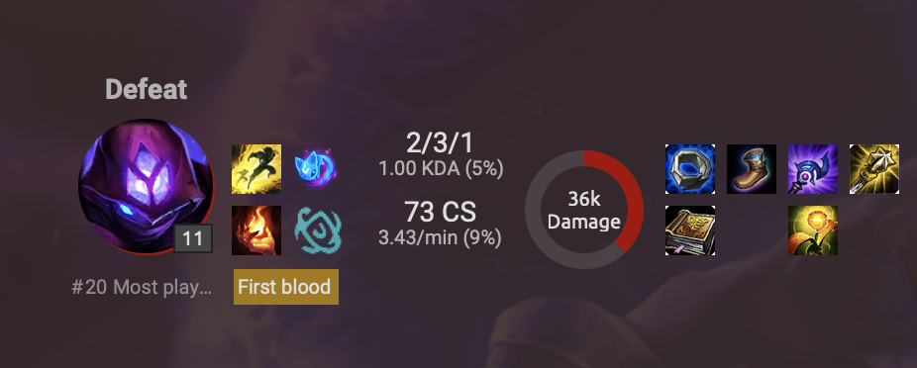
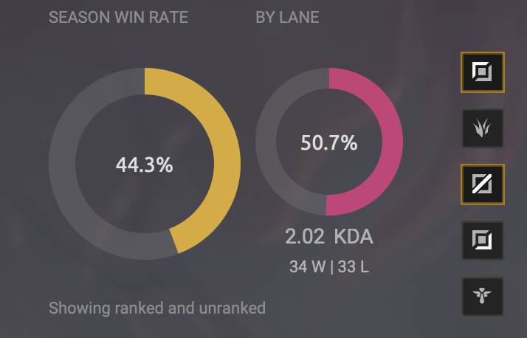
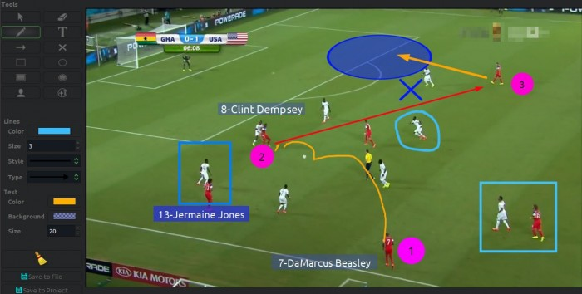
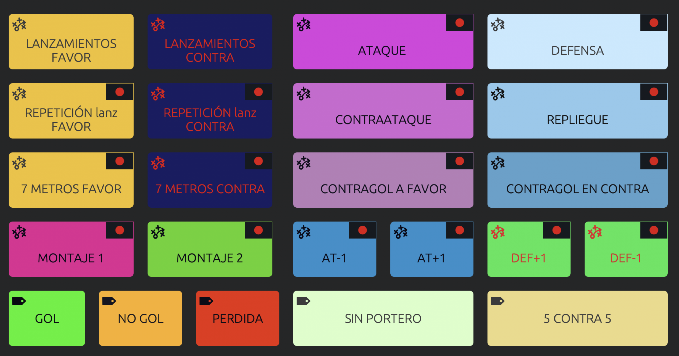
Which views need custom rendering?

Slide 34
Backends
2D Drawing Engine
Cairo
Android Graphics
Cairo:
Windows, macOS, Linux
Core Graphics:
iOS
Android Canvas:
Android
Skia:
Windows, macOS, iOS, Android, Linux
Still not pixel-perfect with Cairo, has issues with CJK fonts
Core Graphics
Skia

Slide 35
Drawing is fun and easier than you think!
You only need 3 abstractions
IBitmap: a buffer that holds the pixels (SKBitmap)
IDrawingView: a view that presents the IBitmap and sends redraw events (SKCanvasView)
ICanvas: host the draw calls to the IBitmap. You can do magic with just a few primitives (SKCanvas)
ICanvas.DrawLine
ICanvas.DrawRectangle
ICanvas.DrawCircle
ICanvas.DrawImage
ICanvas.DrawText
…
A canvas API to hold the state of elements and allow resizing, moving, interacting with elements.

Slide 36
Custom renderers Xamarin.Forms
CoolButton
SVG images: it reduces size and build times a lot, really! (specially in Android)
Custom shapes
Animations
CoolImage
SVG support
Several fit modes
Aspect Fit: keeps the DAR in the designated area adding black borders
Aspect Fill: keeps DAR filling the designated area
Keep: expands the view to render the image with its original size
Fill: fills the designated area without respecting DAR

Slide 37

Architecture

Slide 38

MVVM+S Framework

Slide 39

MVVM... +S?
Separate UI from everything else.
Reuse core logic in all platforms and applications.
Let’s make our own framework. It’s just splitting up Views and Models into ViewModels… how hard can it be?

Slide 40
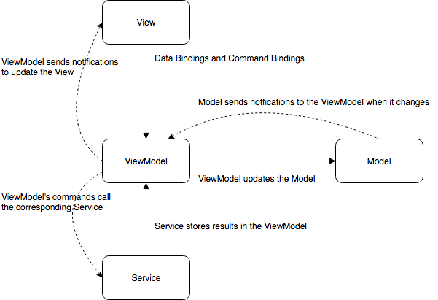
Enter Commands and Services
MVVM is good, but we like our ViewModels dumb.
Commands Available interface in a ViewModel The command action is set from the outside
ViewModel.ReplaceMediaFileCommand.SetCallback (Replace); void Replace (){ Get<IMediaFileService>().Replace (ViewModel.FileSet); }

Slide 41
Enter Commands and Services
MVVM is good, but we need our reusable logic.
Services Implementation of a Command’s interface. Can be shared between VMs

Slide 42
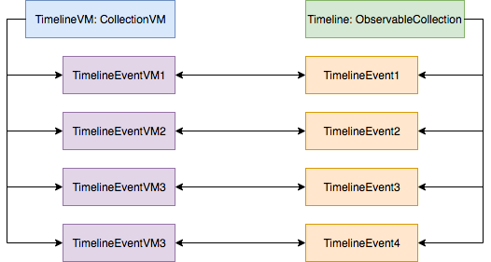
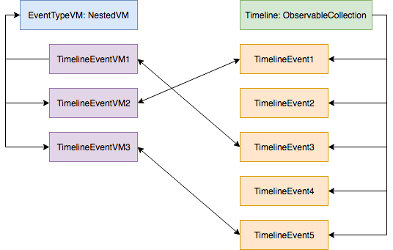
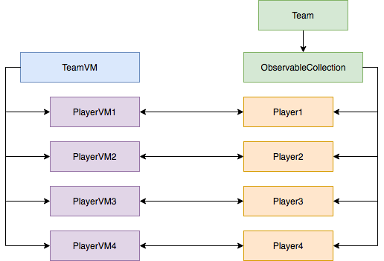

ViewModels for Collections
CollectionViewModel
NestedViewModel
NestedSubViewModel

Slide 43
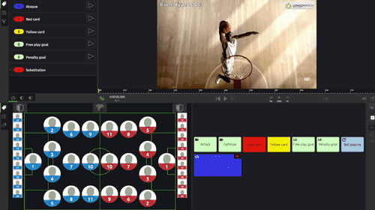

Slide 44
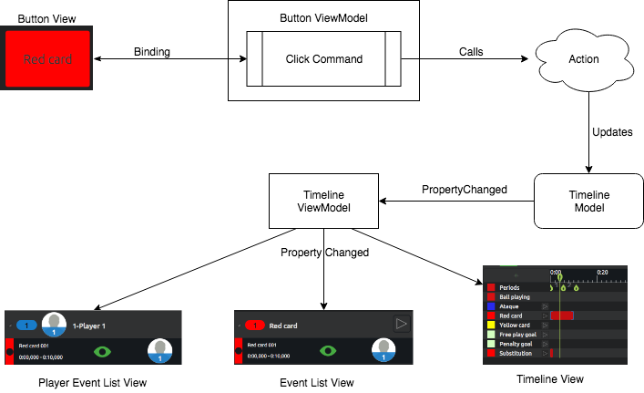

The magic of PropertyChanged

Slide 45

Fody: Black magic!
Avoid reimplementing the PropertyChanged events everywhere
Before code:
public class Person : INotifyPropertyChanged { public event PropertyChangedEventHandler PropertyChanged; public string GivenNames { get; set; } }
What gets compiled:
public class Person : INotifyPropertyChanged { public event PropertyChangedEventHandler PropertyChanged; string givenNames; public string GivenNames { get => givenNames; set { if (value != givenNames) { givenNames = value; OnPropertyChanged(InternalEventArgsCache.GivenNames); } } }
protected void OnPropertyChanged(PropertyChangedEventArgs eventArgs) { PropertyChanged?.Invoke(this, eventArgs); } }

Slide 46
PropertyChanged limitations
Only one level of property notifications -> Forwarder!
The Forwarder is a Fody weaver that automatically connects children to forward PropertyChanged events
public BindableBase PropertyName { get { return propertyName; } set { propertyName = value; } }
void Connect (INotifyPropertyChanged oldValue, INotifyPropertyChanged newValue) { // Disconnect the old value if (oldValue != null) { oldValue.PropertyChanged -= ForwardPropertyChanged; } // Connection the new value if (newValue != null) { newValue.PropertyChanged += ForwardPropertyChanged; } }
public BindableBase PropertyName { get { return propertyName; } set { Connect (base.PropertyName, value); propertyName = value; } }

Slide 47

PropertyChanged limitations
Default events in C# can cause memory leaks → Weak events!
public event PropertyChangedEventHandler PropertyChanged { add { weakEventManager.AddEventHandler (nameof (PropertyChanged), value); } remove { weakEventManager.RemoveEventHandler (nameof (PropertyChanged), value); } }

Slide 48

Data bindings
Xamarin.Forms comes with data bindings integrated
Gtk needed custom bindings.
2108 Lines of code
25 files
38 different commits

Slide 49

Testing

Slide 50
Unit tests
NUnit + Moq
About 3000 unit tests
In the process of adding even more with BDD

Slide 51
BDD / Feature tests
Almost End to end tests
We act like a user would, but without external backends:
Initialize the whole application
Execute the available Commands
Assert the results in the ViewModels

Slide 52
LongoMatch Desktop
LongoMatch Mobile
RiftAnalyst
RA.DB
LongoMatch Core
RiftAnalyst Core
VAS
Services
Database
Multimedia Engine
2D Drawing Engine
UI Engine
MOCKED!
MOCKED!
MOCKED!
MOCKED!
Cairo
Android Graphics
Couchbase
Google Cloud Store
GStreamer
Android Media
AV Foundation
GTK+
Xamarin.Forms
Core Graphics
Skia
Xamarin.Mac
Xamarin.Android
Xamarin.iOS
Mono
.NET Framework
.NET Core

Slide 53

UI tests
Mobile only
Work in Progress for desktop.
Sadly, the framework breaks frequently

Slide 54
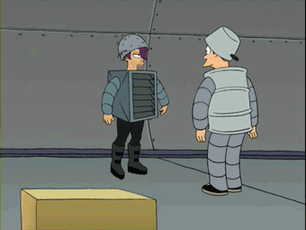
CI / CD

Slide 55

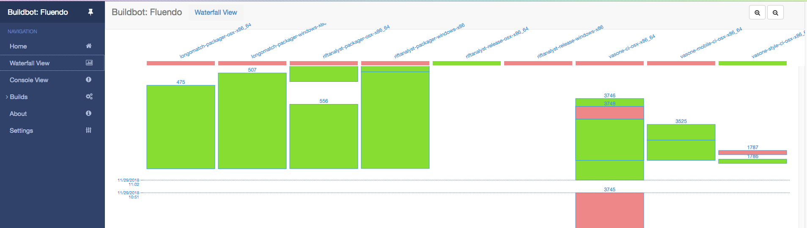
Buildbot
Flexible - Configuration is code
Stable - 15 years of development
Buildsystem agnostic
Ugly
Complicated
Build decoupled from code

Slide 56
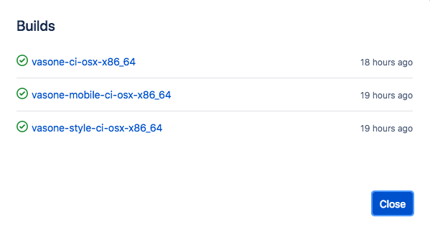
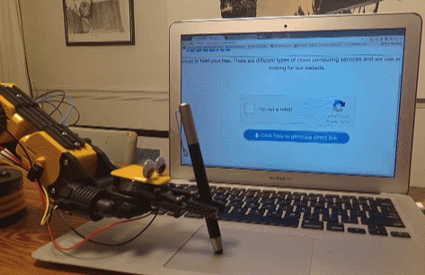
CI/CD
Each Pull Request runs our CI set
Unit + Feature tests
Mobile tests (build + UITest)
Style checks
Each merge runs our packaging process
Development build from master
Release build from release
Desktop packages uploaded to shared storage
Mobile apps uploaded to alpha tracks in the stores

Slide 57

Usage & KPIs

Slide 58
Usage information
Information flow:
Desktop Application → HockeyApp
Mobile Application → AppCenter
HockeyApp?
We had to tweak a big part of the Windows SDK to make it work with Mono
Allows joint management of events
AppInsights

Slide 59
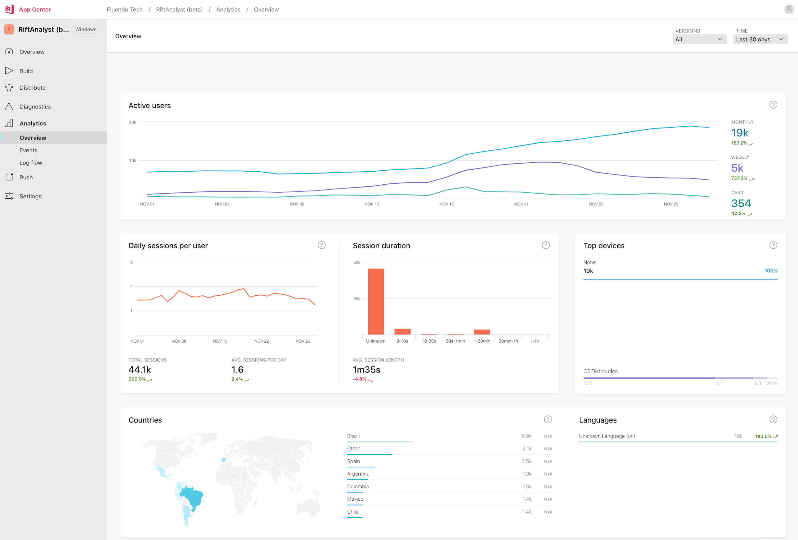
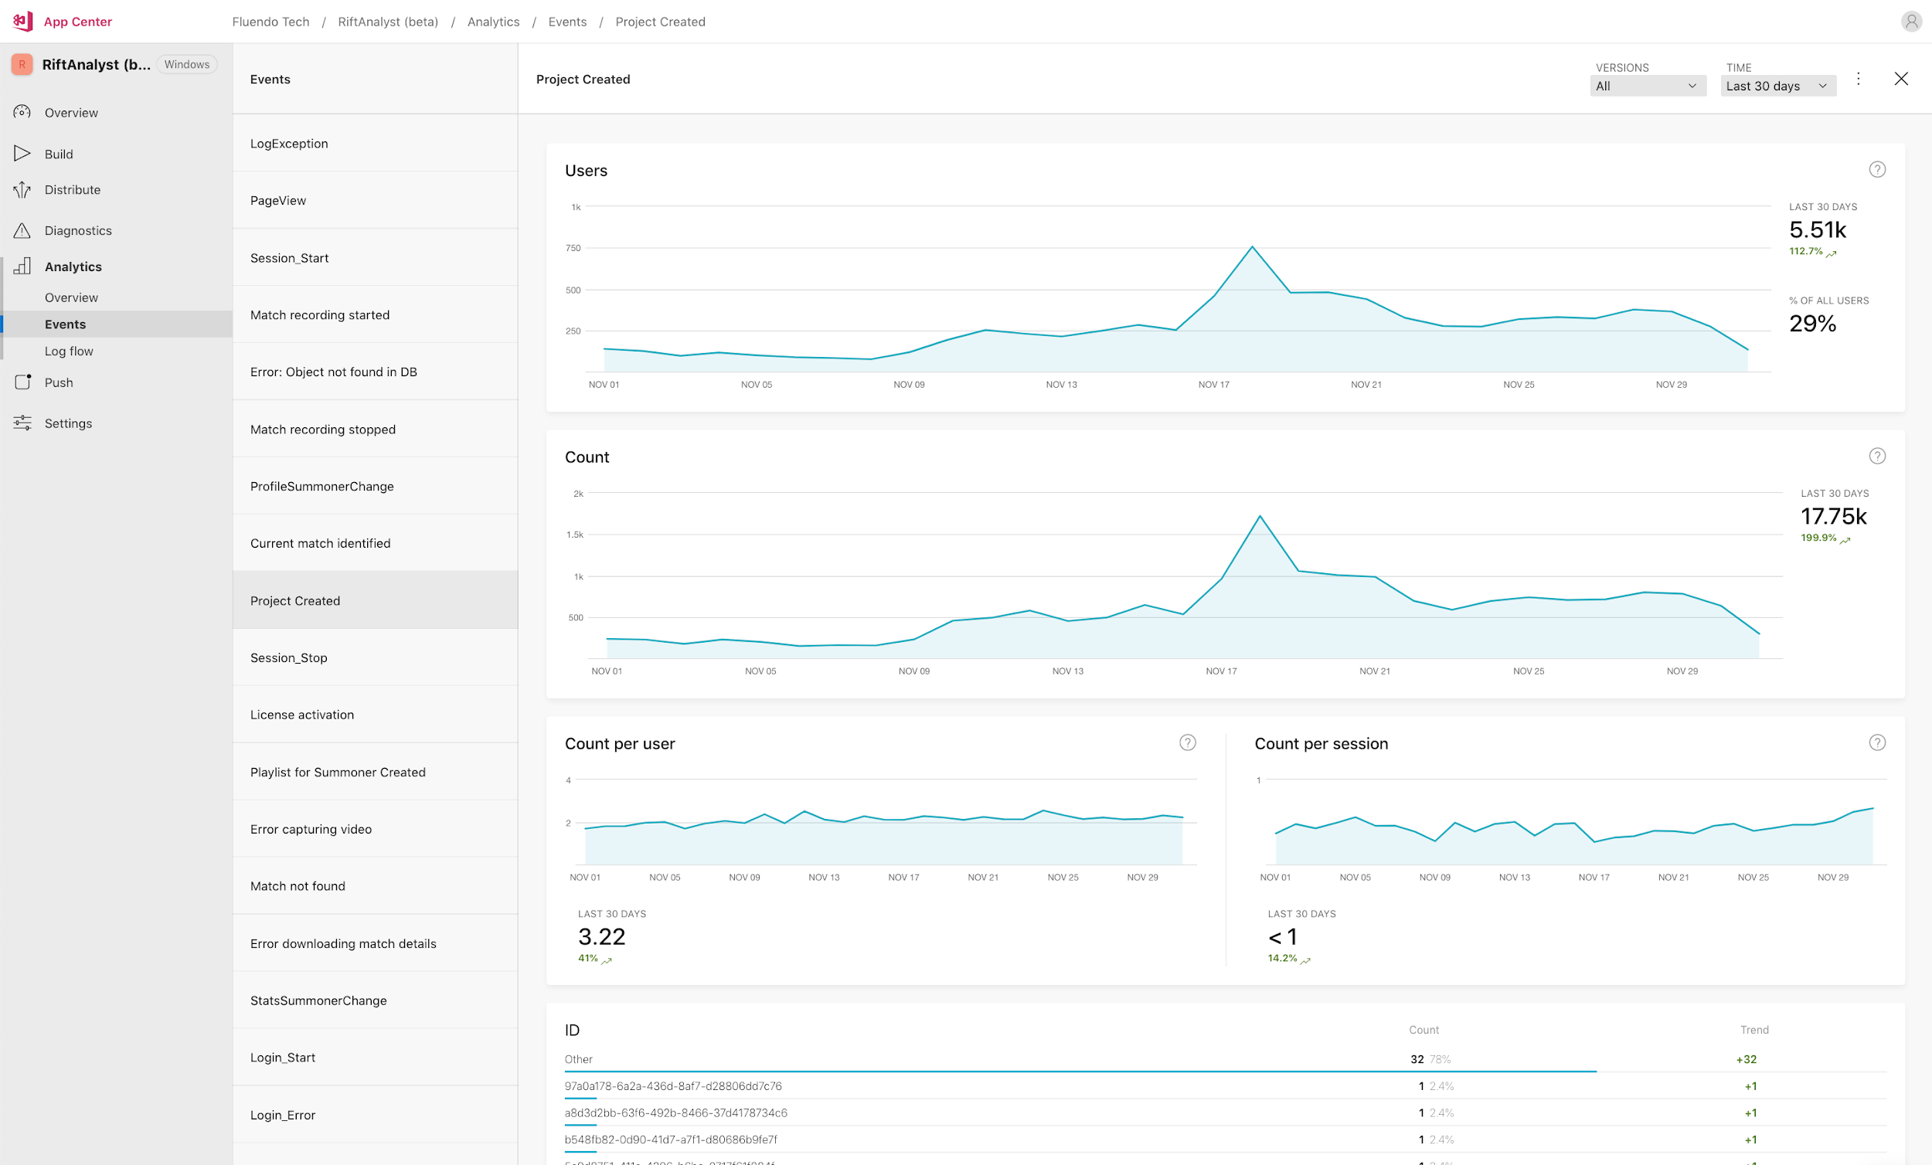
Usage KPI’s, custom events, errors

Slide 60
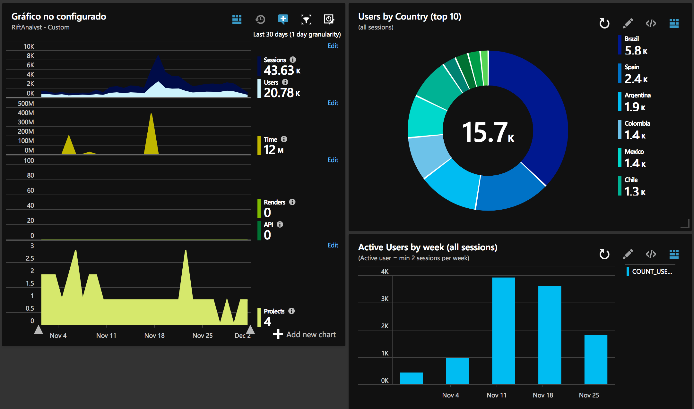
Usage KPI’s, custom events, errors

Slide 61
Xamarin.Forms with the
Gtk+ backend

Slide 62
Current status
We use it in Windows and macOS
We contributed 9 patches upstream
It’s quite stable for our use cases
It allows use migrating progressively, we still have many pure Gtk+ widgets
There is still some work to do, we need more people using it with more use cases
HiDPI is not supported in Windows, this is our biggest issue right now

Slide 63

Thanks for listening!

